Slide 1
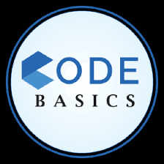
PROVIDE INSIGHTS TO TELENGANA GOVERNMENT TOURISM DEPARTMENT
domain: tourism
Presented by: Shashank Prakash Patil

Slide 2
Objective
The objective is to conduct a comprehensive analysis of tourist data from 2016 to 2019 in Telangana, covering both domestic and foreign visitors. The insights gained from this analysis will assist the government of Telangana in formulating strategies and implementing measures to increase tourism and generate more revenue from it.

Slide 3
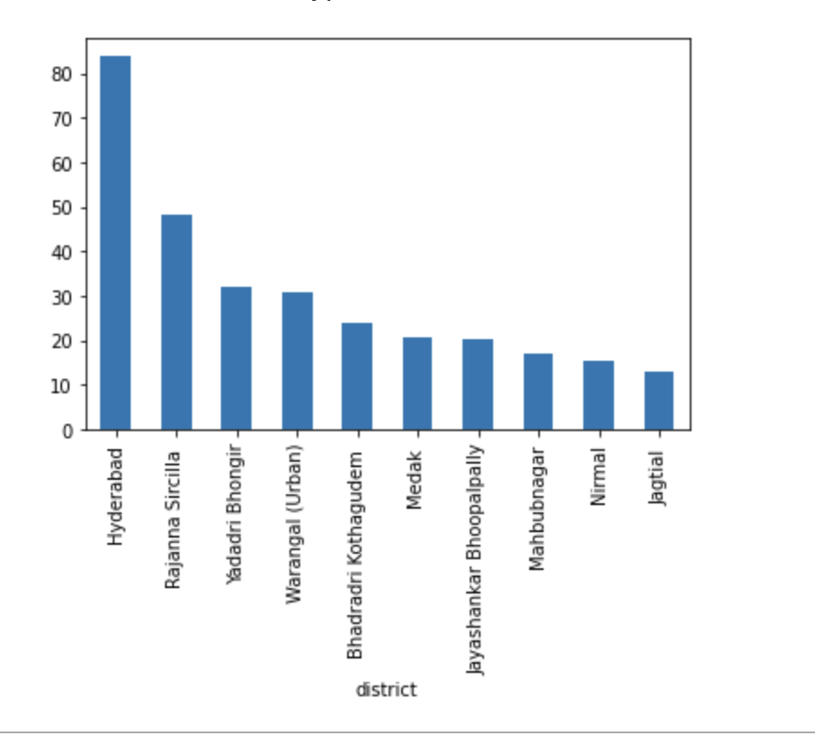
DISTRICTS WITH HIGHEST NUMBER OF Domestic VISITORS FROM 2016 TO 2019
The capital city of Hyderabad has the highest number of domestic visitors in Telangana, with a whopping 83.9 million visitors from 2016 to 2019. Following Hyderabad, the districts of Rangareddy, Medchal Malkajgiri, Warangal Urban, Nizamabad, Khammam, Mahabubnagar, Karimnagar, Sangareddy, and Adilabad
Hyderabad attracts the highest number of visitors in Telangana due to its status as the state capital, as well as the presence of numerous tourist attractions and better infrastructure in the city.

Slide 4
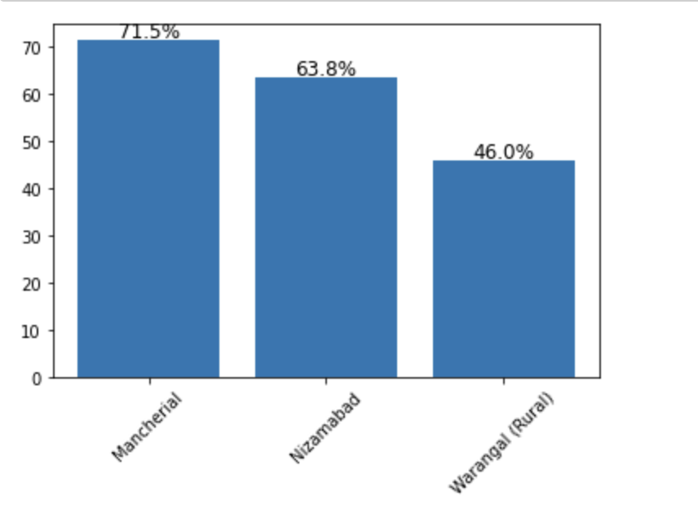
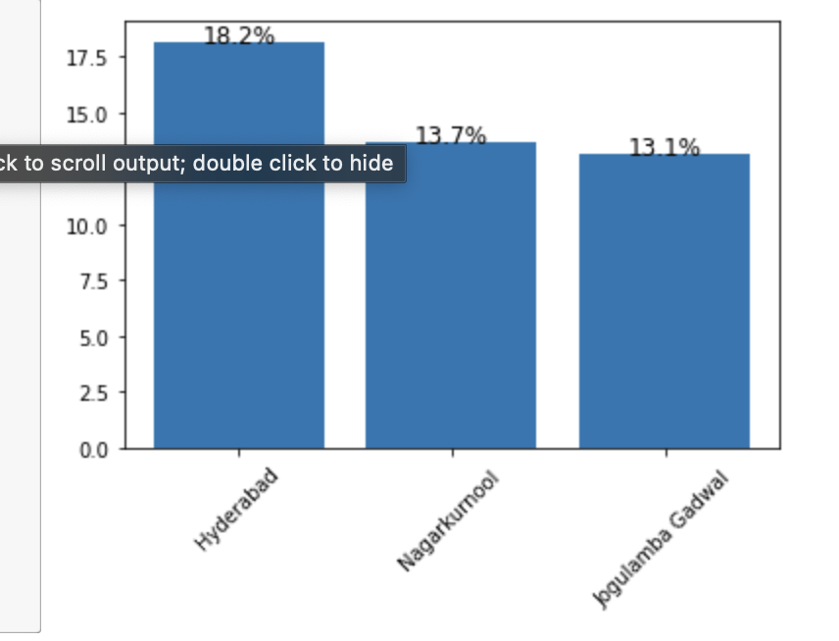
Top 3 district based on compounded annual growth rate
Mancherial district has the highest compounded annual growth rate of 71.48% which is followed by Nizamabad and Warangal(Rural) for the domestic visitors
Hyderabad has the highest compounded annual growth rate of 18.2% which is followed by Nagarkurnool and Jogulamba Gadwal for the foreign visitors

Slide 5
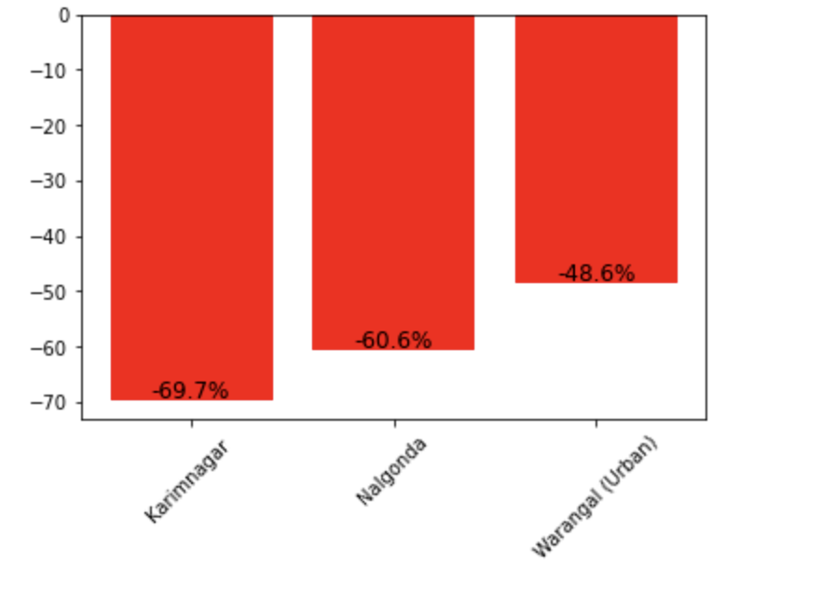
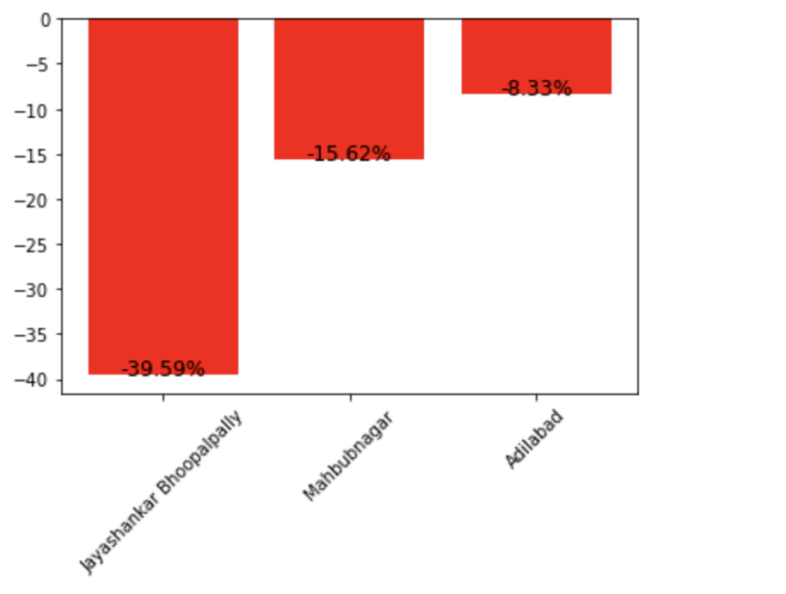
Bottom 3 district based on compounded annual growth rate
Karimnagar district has the lowest compounded annual growth rate of -69.7 which is followed by Nalgonda and Warangal(Urban) for the domestic visitors
Based on the available data Jangaon had only 2 visitors in 2016 and in 2017,2018,2019 the number of visitors data present in 0
Jayashankar Bhoopalpally district has the lowest compounded annual growth rate of -39.59 which is followed by Mahbubnagar and Adilabad for the foreign visitors

Slide 6
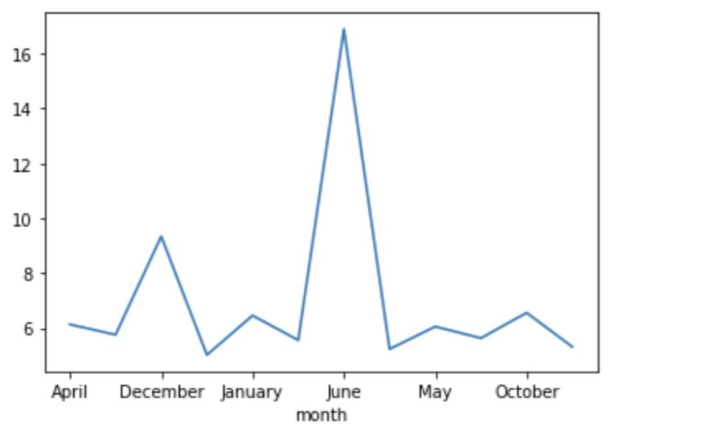
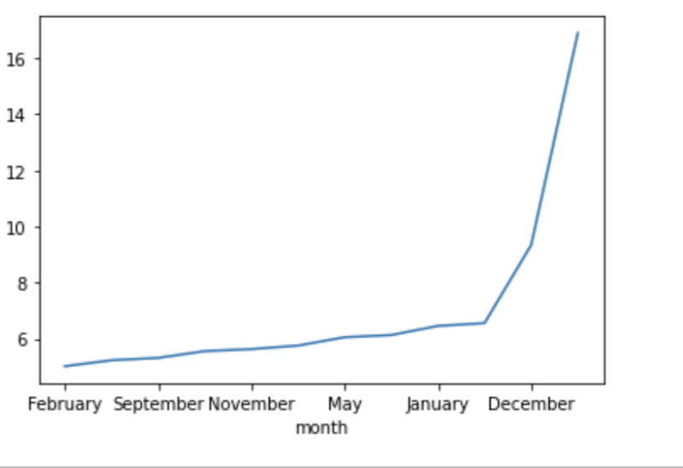
The peak seasons and low seasons months for Hyderabad
June is the peak season which has the highest number of visitors to Hyderabad district
June is a popular month for events and festivals in Hyderabad, such as the annual Bonalu festival, which could draw in more visitors to the city.
February has the lowest number of visitors to Hyderabad district
The temperature in the month of February is between 15-25 degrees which may be unfavorable for tourists to travel and also the number of events and festivals are comparatively less which could result to low number of tourist

Slide 7
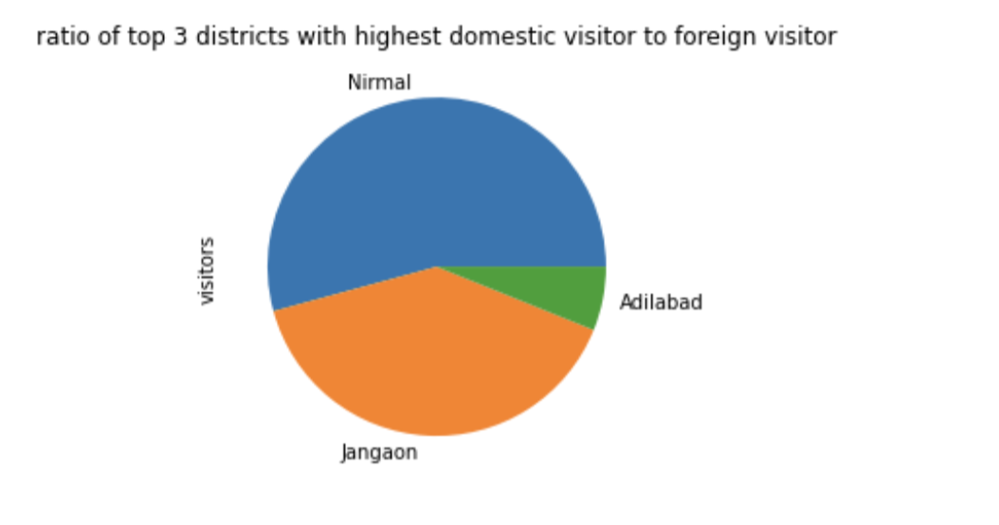
Top 3 district with high domestic to foreign tourist ratio
The top 3 districts with high domestic to foreign tourist ratio is Nirmal which is followed by Jangaon and then Adilabad

Slide 8
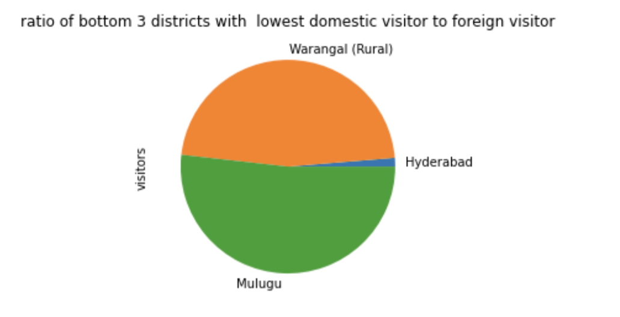
Bottom 3 district with high domestic to foreign tourist ratio
The bottom 3 districts with lowest domestic to foreign tourist ratio is Hyderabad which is followed by Warangal (Rural) and then Mulugu

Slide 9
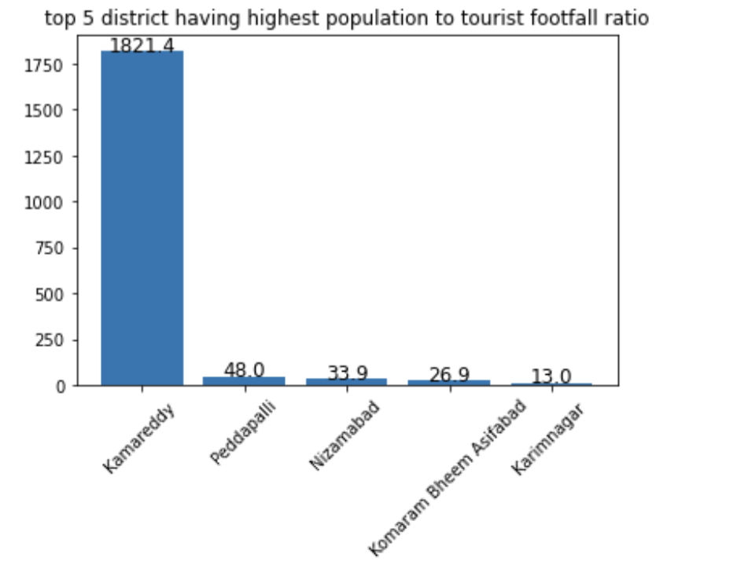
TOP 5 Districts based on population to tourist footfall Ratio
The top 5 districts based on population to tourist footfall ratio are Kamareddy which is followed by Peddapalli,Nizamabad, Komaram Bheem Asifabad and Karimnagar
These districts tend to have more population but less visitors .The tourism department should campaign the tourist spots ,culture and events that are present in the districts by using social media which would not only help government to generate revenue but also help local resident to generate employment due to tourism

Slide 10
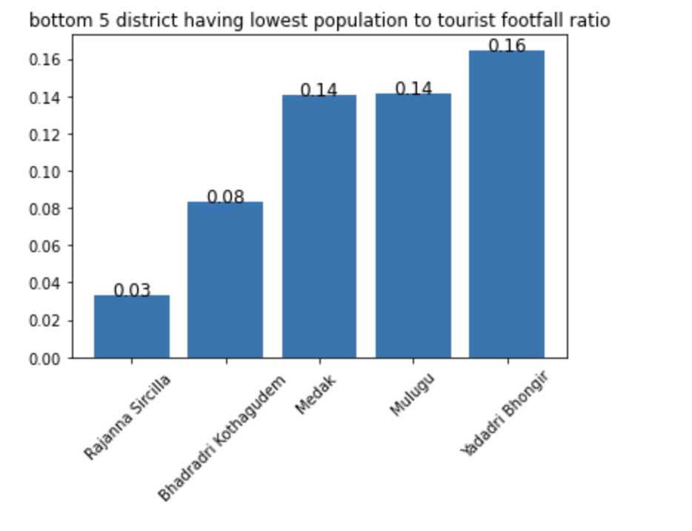
Bottom 5 Districts based on population to tourist footfall Ratio
The bottom 5 district based on population to tourist footfall ratio are Rajanna Sircilla followed by Bhadradri Kothagudem ,Medak ,Mulugu and Yadadri Bhongir
The inflow of tourist is more than the population. The government should focus on encouraging the hospitality industry to build hotels to accommodate more visitors as districts with low population tend to have less hotels
The government should invest on increasing transportation facility by deploying more buses, setting up taxi service where all the taxi service and fares are being regulated by the government

Slide 11
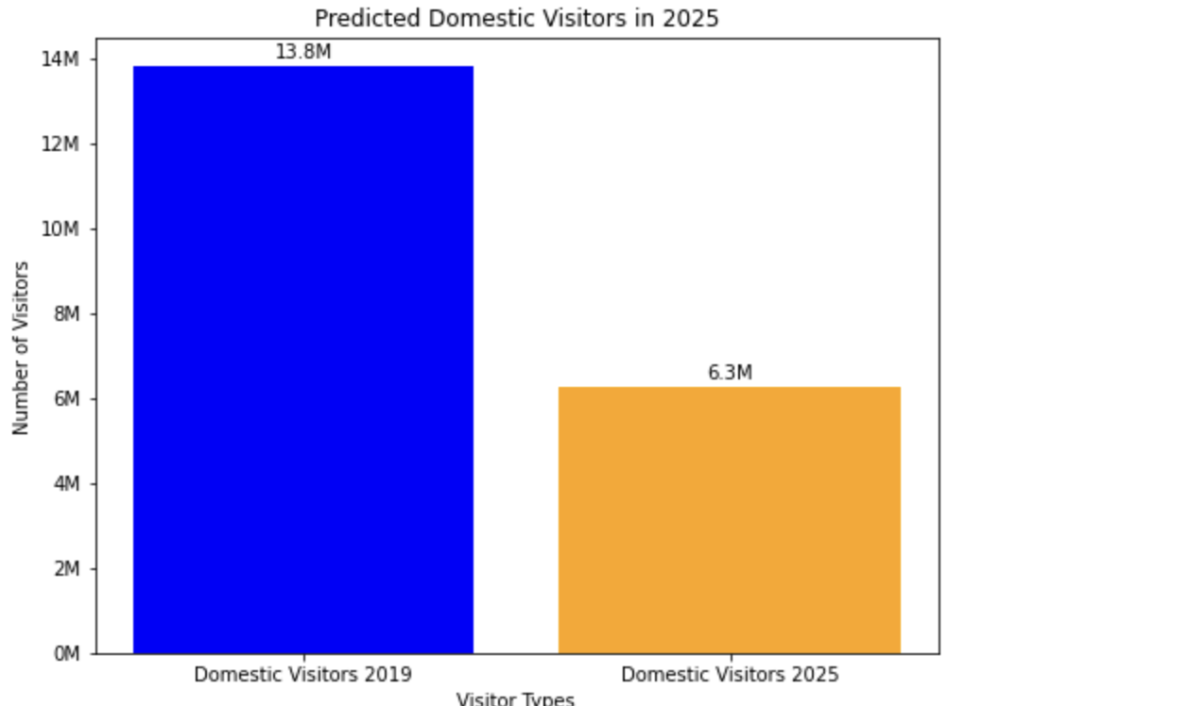
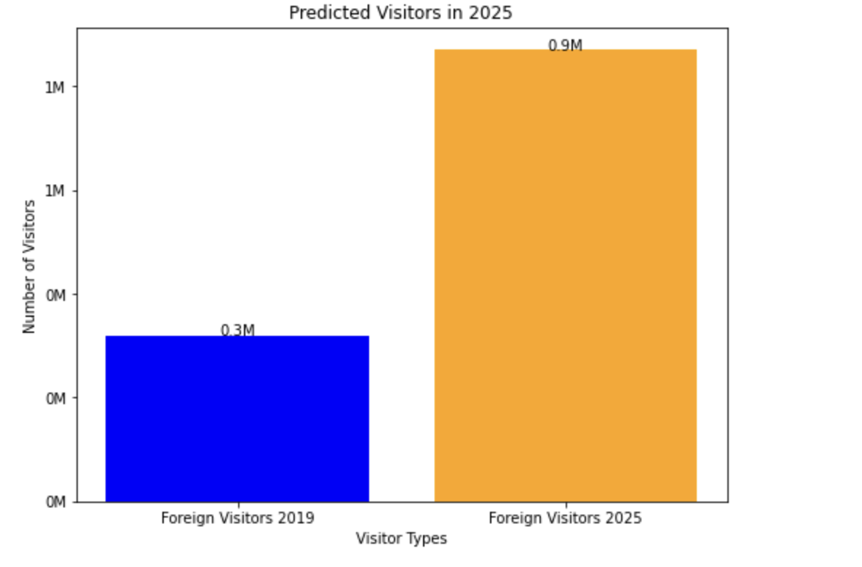
Projected Number of domestic and foreign visitor in Hyderabad in 2025
The projected number of domestic visitors in Hyderabad district in 2025 is estimated to be around 6.3 million visitors, considering the CAGR of –12.35%
The visitors to Hyderabad district in 2019 was 13.8 million, where the number of visitors are expected to drop by 54 percent in 2025
The projected number of domestic visitors in Hyderabad district in 2025 is estimated to be around 0.9 million visitors, considering the CAGR of 18.19%
The visitors to Hyderabad district in 2019 was 0.3 million, where the number of visitors are expected to increase by 66 percent in 2025

Slide 12
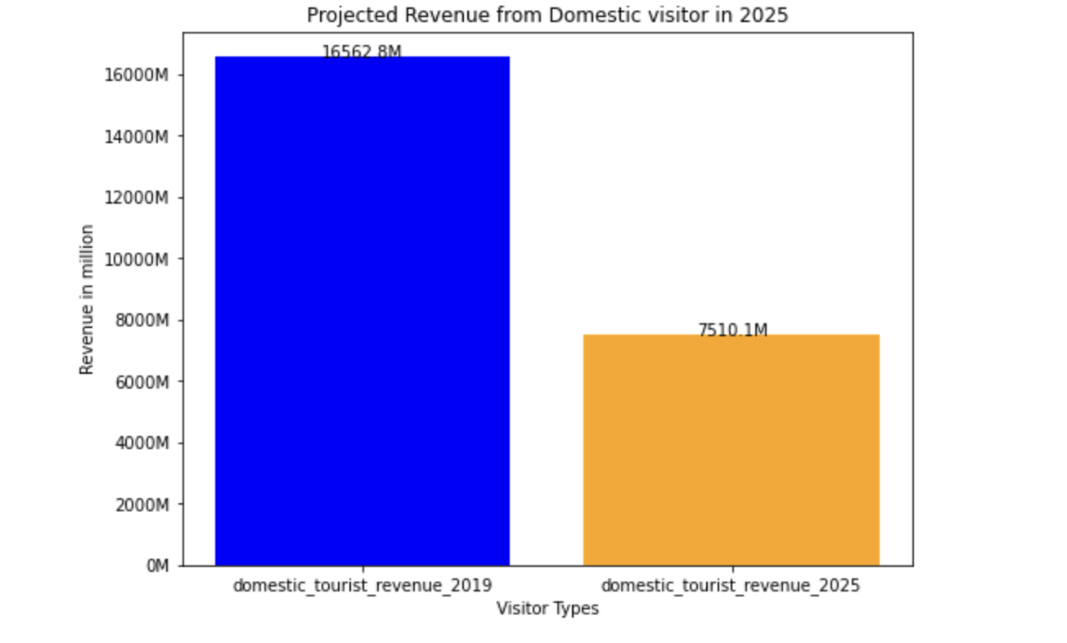
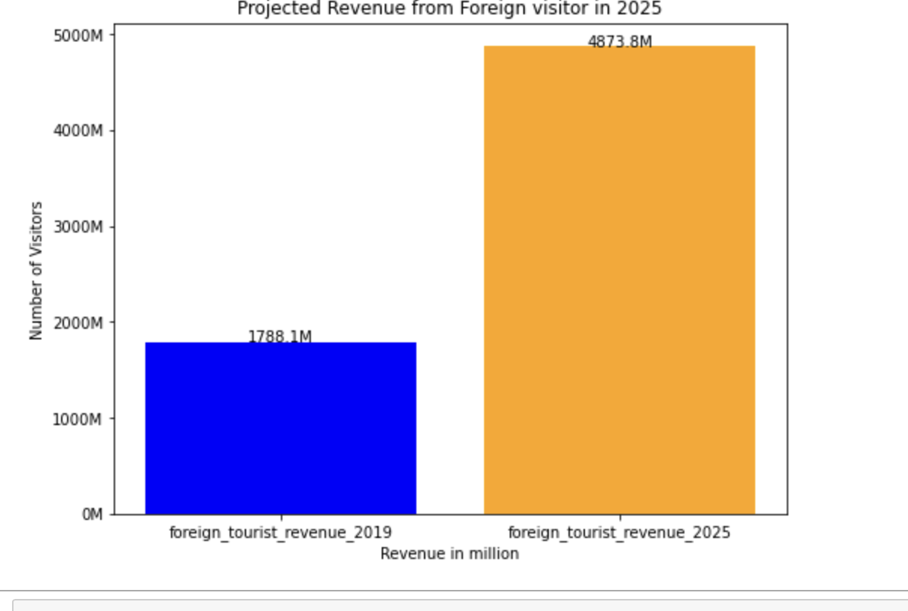
Projected revenue in 2025 in Hyderabad district
The projected revenue generation from domestic visitor in 2025 in Hyderabad district is Rs. 7510.1 M
The revenue generated from domestic visitor in 2019 in Hyderabad district is Rs 16562.8 M, where the revenue is projected to be dropped by 54 percent
The projected revenue generation from foreign visitor in 2025 in Hyderabad district is Rs. 4873.98
The revenue generated from domestic visitor in 2019 in Hyderabad district is Rs 1788.1 M, M, where the revenue is projected to be increased by 63 percent

Slide 13
District with highest potential
Districts such as Mancherial , Nizamabad, Warangal(Rural) have the highest potential as these districts have higher compound annual growth rate
Hyderabad being the capital city has the highest number of visitors as it the capital city of the state of Telangana as it houses various tourist spots and corporate companies
Tourism department should promote the cultural events that happen in these districts and brief history of these tourist places and government should prioritize in making better infrastructure .This would help to boost tourism in these districts which have highest potential

Slide 14
Cultural and corporate event to boost tourism
Telangana is a state rich in cultural heritage and has a lot to offer in terms of tourism. Here are some cultural and corporate events that can be conducted in Telangana state to boost tourism:
1. Bonalu Festival: A folk festival honoring Goddess Mahankali with cultural programs and processions.
2. Telangana Food Festival: A culinary festival showcasing the state's unique and spicy dishes.
3. Hyderabad Literary Festival: A literary festival celebrating the state's renowned writers and poets.
4. Telangana Tourism Expo: An expo highlighting the state's natural beauty and cultural heritage.
5. Telangana IT Summit: An event showcasing the state's IT and software development capabilities.
6. Telangana Handicrafts Fair: A fair showcasing the state's handicrafts, including textiles, ceramics, and woodwork.
7. Telangana International Film Festival: A film festival showcasing the state's film-making potential. These are just a few of the many cultural and corporate events that can be conducted in
Telangana state to boost tourism. By showcasing the state's rich cultural heritage and natural beauty, Telangana can attract tourists from all over the world and establish itself as a leading tourist destination.

Slide 15
Can Hyderabad emulate Dubai model?
Emulating Dubai's tourism model in Hyderabad is challenging. Dubai's tourism success comes from excellent infrastructure, strict laws for safety, and various tourist attractions. Hyderabad lacks perfect infrastructure, transportation facilities, and crimes such as robbery, theft, attacks, sexual harrasments to female traveller which is serious issue not only in Hyderabad but across India which discourages tourism. To emulate Dubai, Telangana government needs to invest in infrastructure, popular tourist spots, CCTV surveillance, and police patrols. Strict law enforcement is necessary for a safe environment. Emulating Dubai's tourism model in Hyderabad requires a comprehensive and sustained effort from the government to improve infrastructure, security, and tourism.

Slide 16
Recommendation to boost tourism in the state of Telangana
Hyderabad has the highest number of visitors compared to other districts in the state of Telangana. The main reason for this better infrastructure compared to other districts
To boost tourism, the tourism department should promote tourism through social media such as Facebook and Instagram on regular basis and roll out advertisement with prominent figures portraying the beauty of Telangana state in Television
The key thing the government should do to boost tourism is to spend more on developing better infrastructure, which includes better roads ,improving traffic condition and ensuring cleanliness in the city and improvise law enforcement by installing cctv camera in all the crucial place in all the districts
The government should take up initiative to develop new tourist spots which tourists of this generation tend to visit a lot and attracts foreign visitors as well .
Organize cultural and corporate events which would help the government to promote tourism

